Slide 1

IND256x Weighing Terminal
Mettler Toledo
May 6, 2019
For Zone 1/21, Division 1 Hazardous Area

Slide 2
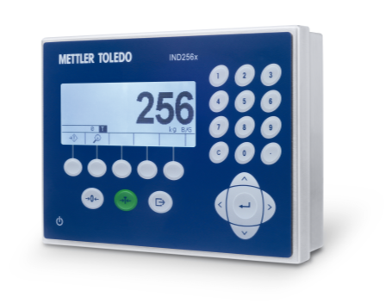
Product Design - Profile
System info line
can show
date/time
and warning prompt
Numeric Keypad
Graphic LCD with
white back light and
25mm weight height
Navigation Key
Customized soft keys
Notes:
WIFI and analog can not be used together

Slide 3
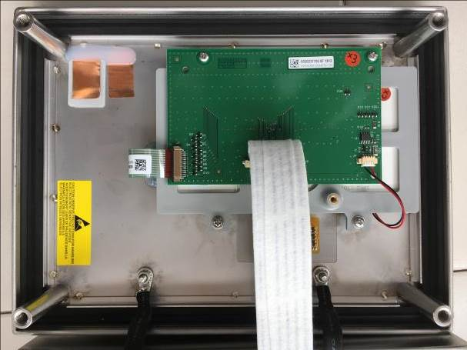
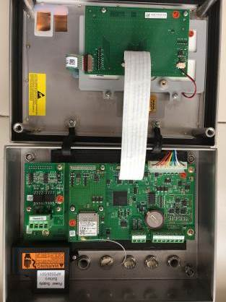
Product Design - Front Cover
Keypad
Display board
LCD display
(The same size with IND246)

Slide 4
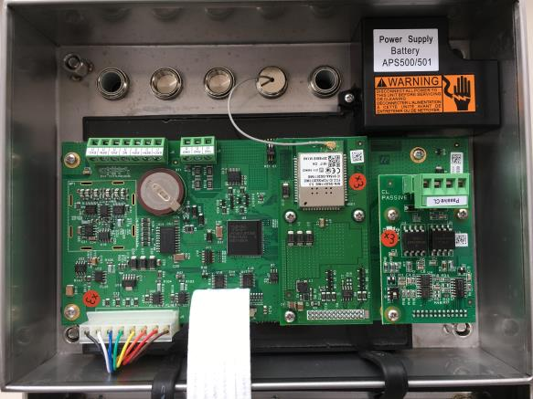
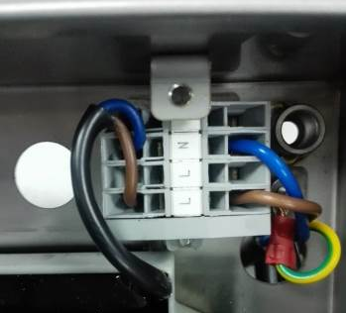
Product Design - Rear Part
Analog scale interface
COM1
IS RS232
Internal power supply
(capsulated in box – Ex mb)
Power Connector
(Covered by small housing)
Power input connector
(Increased safety – Ex e)
Connectors for
internal power supply
COM2
Wi-Fi or Analog Output
COM3:
Active CL or
Passive CL

Slide 5
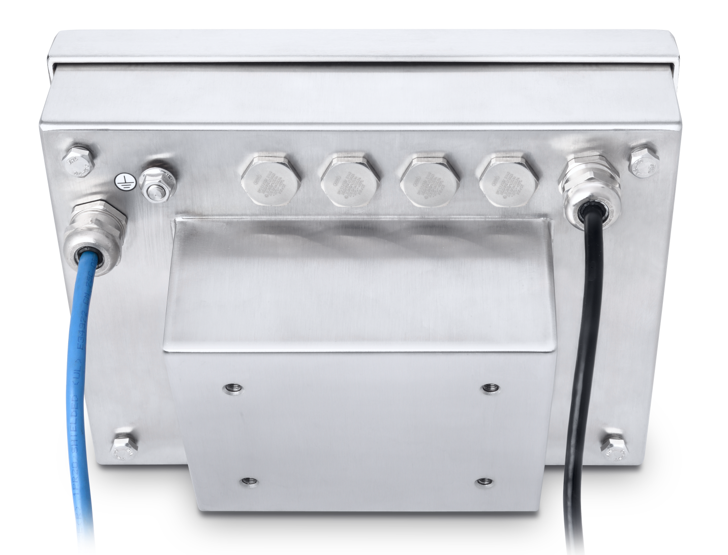
Product Design - Interface
Integrated power module and communication interface design
Power input
COM3
COM2
Reserved
COM1
Scale interface
Power input
  AC (87-250V 50/60Hz)
  DC 24V(18V – 30V)
  External battery(NiMH)
Scale interface
  Analog load cell
COM1 (fixed)
  Intrinsically safe RS232
COM2 (option)
  Wireless module
  Analog Output
COM3 (option)
  Active current loop
  Passive current loop
Reserved COM – n.a.

Slide 6

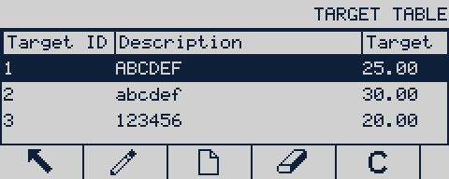


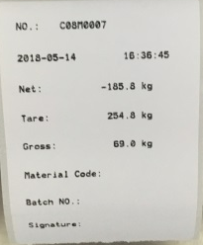
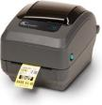
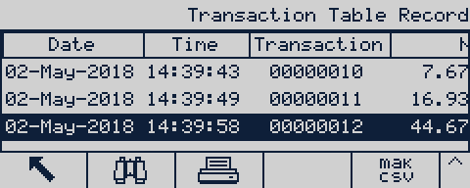
Key Applications
Flexible solutions for manual simple & check weighing
Label Printing
Flexible ways to meet traceability
Support ASCII and label printers (EPL & ZPL )
Weighing Trace
Fast and easy operation
60,000 logs capability
5 customized printing templates
3 IDs entry assigned as material No., batch No. etc
Stored or exported via serial port and Wi-Fi
Serial or Ethernet connection
Results can be stored and printed
25 pre-set target table
3 graphic status indication for under/ok/above
Increase the productivity of quality control
CheckWeighing

Slide 7
IND256x Ordering
Use different ways to order IND256x without Wi-Fi and with Wi-Fi!
 | IND256x without Wi-Fi | IND256x with Wi-Fi
Order numbers | VC module - 30315272 Active or Passive CL Power input Regions Wi-Fi unavailable in VC | Only 6 BT1 numbers Wi-Fi as standard Different power inputs Regions – AP/EU
Ex Marking | AC and DC version: II 2G Ex eb ib [ib] mb IIC T4 Gb II 2D Ex tb [ib] IIIC T60°C Db Battery version II 2G Ex ib IIC T4 Gb II 2D Ex tb [ib] IIIC T60°C Db | AC and DC version: II 2G Ex eb ib [ib] mb IIB T4 Gb II 2D Ex tb [ib] IIIC T60°C Db Battery version II 2G Ex ib IIB T4 Gb II 2D Ex tb [ib] IIIC T60°C Db
Consideration | Fit to the highest gas group (IIC) NOT allow to retrofit Wi-Fi | Not allow to be used in IIC group Allow to retrofit Active/Passive CL Wi-Fi spare parts supported

Slide 8
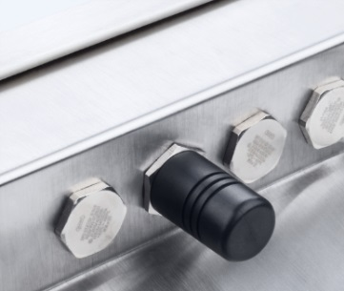
Production Design – Wi-Fi Option
The specification of IND256x build-in Wi-Fi module
Installation | Build-In module option on COM2
Standard | 802.11 b/g/n
Max average RF output | 14dBm
RF Frequency Range | 2.4GHz – 2.497GHz
Encryption | WEP, WPA
WEP | 64 Bit, 128 Bit
WPA | WPA-TKIP, WPA2-AES
Protocol | TCP/IP
Work Mode | Server (only valid via Port 1701), Client
Transmitting distance | Max 40 meters in the open air Typical 20 meters with limited block
Radio Approval | Europe: CE/EMC+CE/RF US: FCC China: SRRC

Slide 9

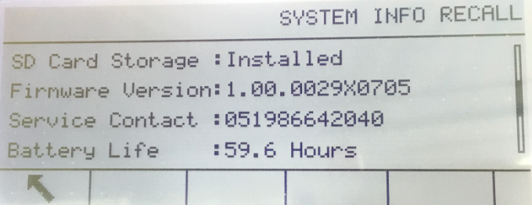
Battery Uptime
Fully support continuous work for several days
Default configuration – without option boards and connect 1-350Ω load cell
  Backlight off 60 hours
  Backlight high 40 hours
Wi-Fi connection – without other options and connect 1-350Ω load cell
  Backlight off 40 hours
  Backlight high 30 hours
Max configuration – with Wi-Fi & Passive CL and connect 4-350Ω load cells
  Backlight off 30 hours
  Backlight high 25 hours
Quickly check battery uptime in Info Page

Slide 10
Service – Spare Parts
No repairing, only replacement
No. | BOM | Description
1 | 30315342 | Front cover and keypad
2 | 30315344 | 230VAC power board
3 | 30315345 | 24VDC power board
4 | 30315346 | Battery power board
5 | 30315347 | Enclosure sealing
6 | 30315348 | Power connector and cover
7 | 30315349 | Mainboard(support Wi-Fi for IIB)
8 | 30458680 | Mainboard(Not support Wi-Fi for IIC)
9 | 30315350 | Display junction board
10 | 30315351 | LCD display
11 | 30458681 | Wi-Fi board spare part
12 | 30344950 | Active current loop I/F kit
13 | 30344951 | Passive current loop I/F kit
14 | 30458682 | Wi-Fi Antenna spare part
15 | 30516677 | 4-20mA analog output board spare part

